Slide 1
T1A2 – Portfolio Slide Deck
Edward Dougherty

Slide 2
Overview
A walk-through of your portfolio website and its features
A walk-through of your design process and decisions
A review of your development/build process including challenges, ethical issues, favourite parts, etc

Slide 3
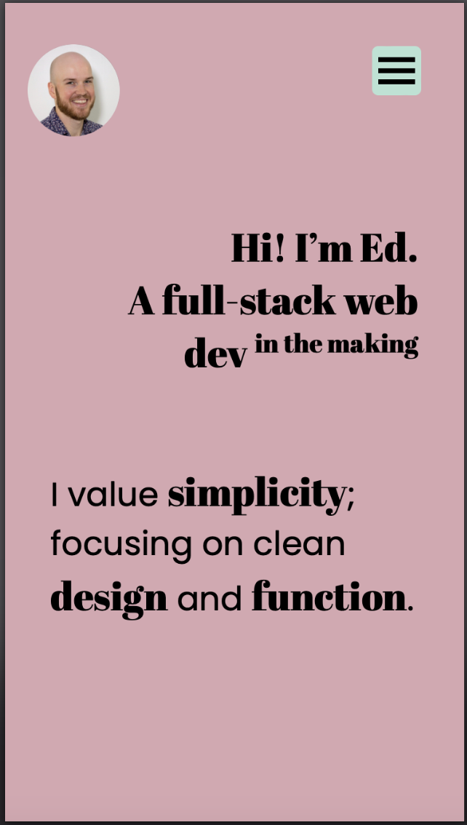
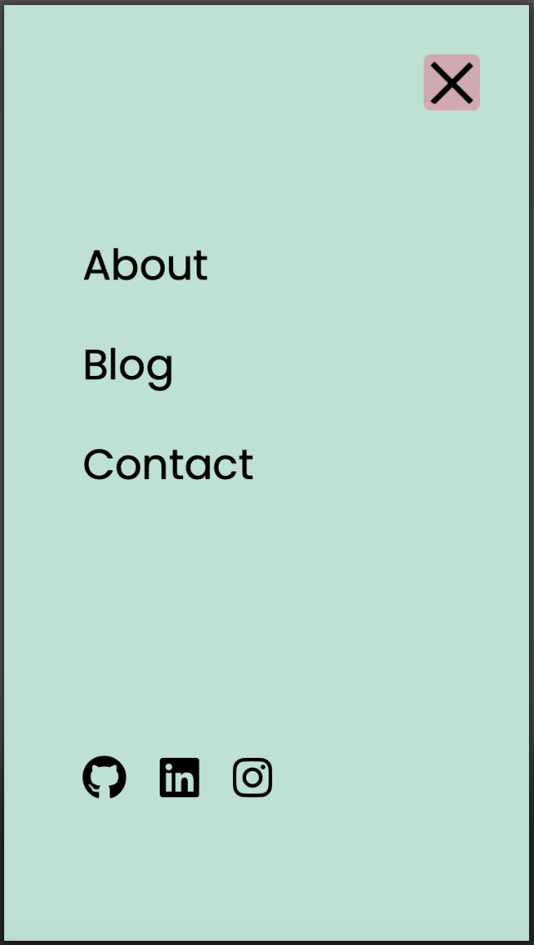
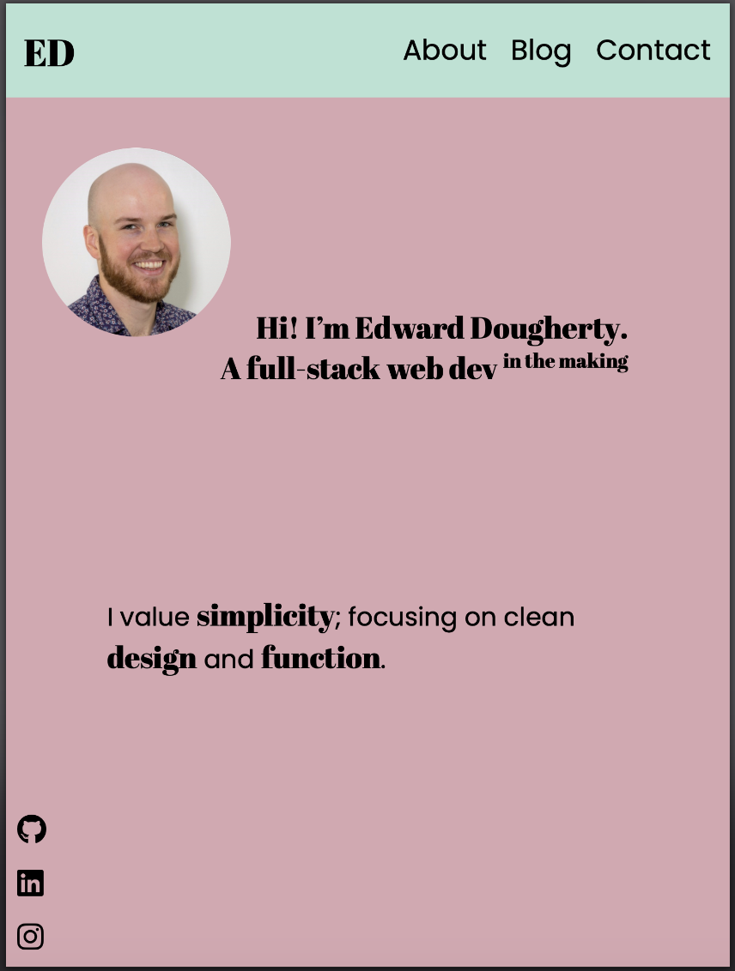
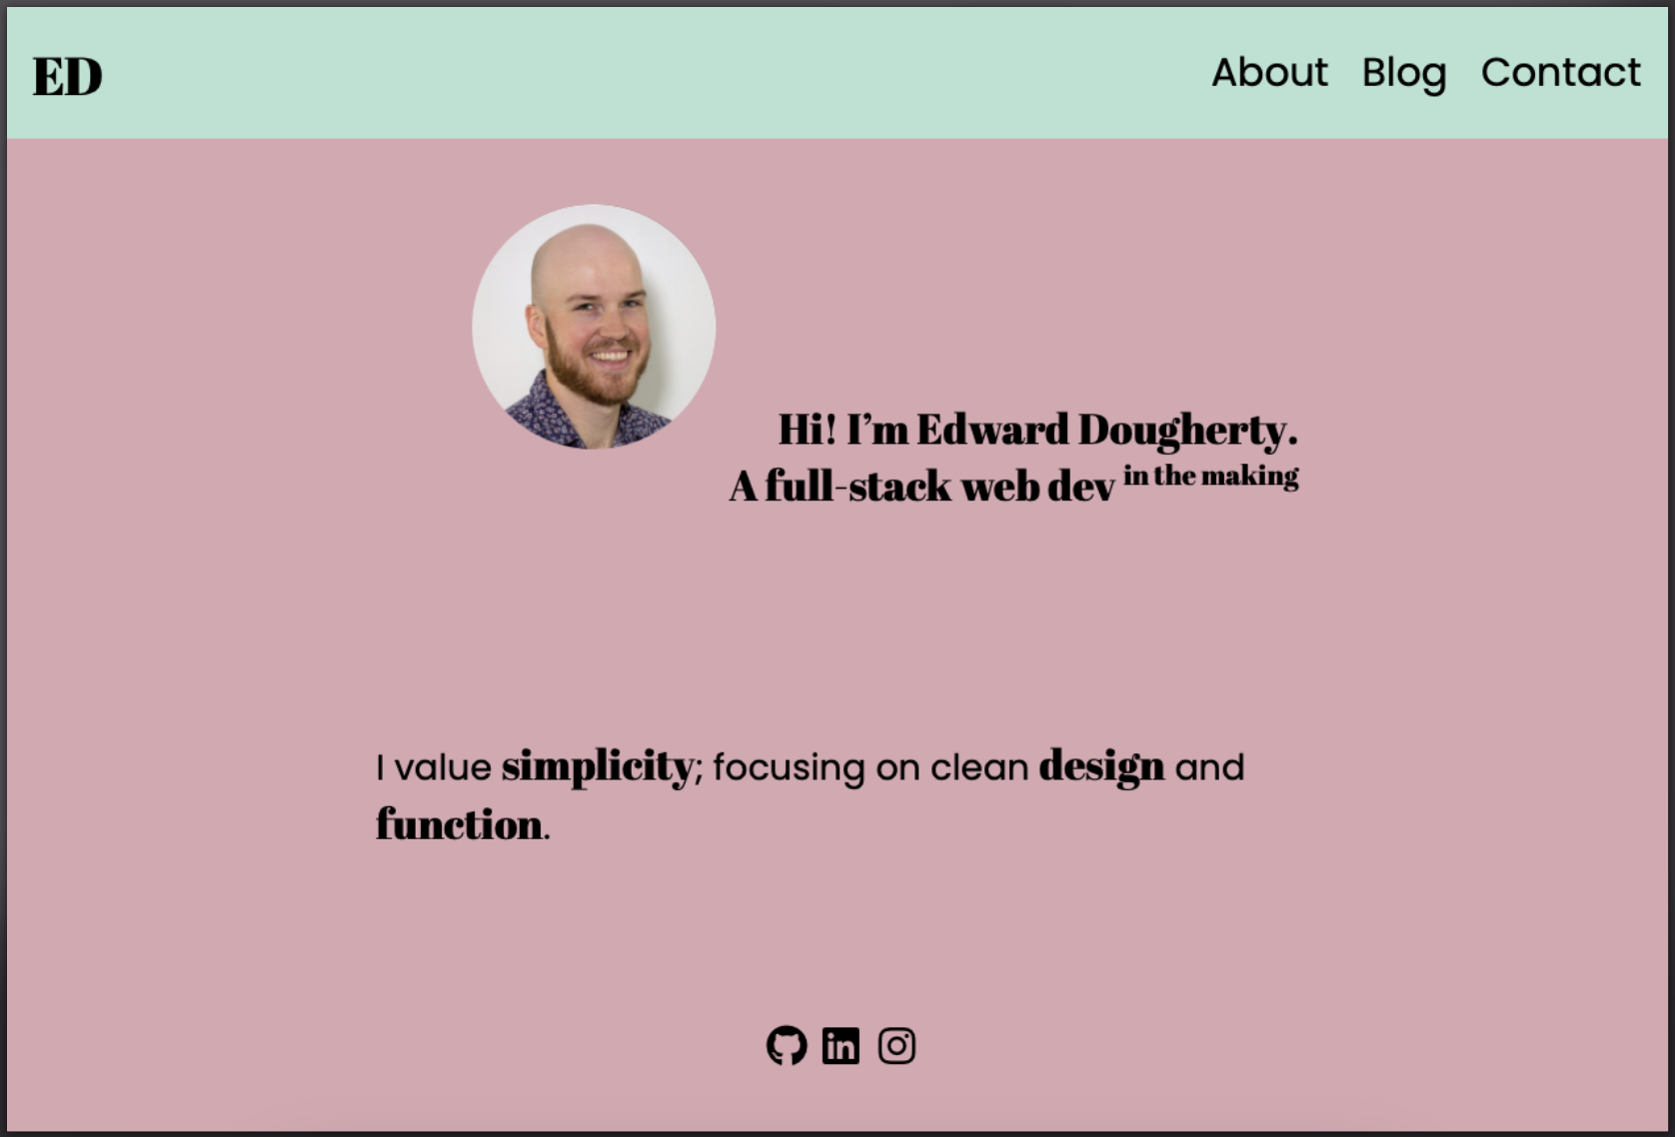
Portfolio Site – Home Page
Features:
Small/Mobile View
Hamburger menu with overlay
Medium/Tablet View
Scalable elements
Social elements left hand side
Visible header
Large/Desktop View
Centred elements for wider displays

Slide 4
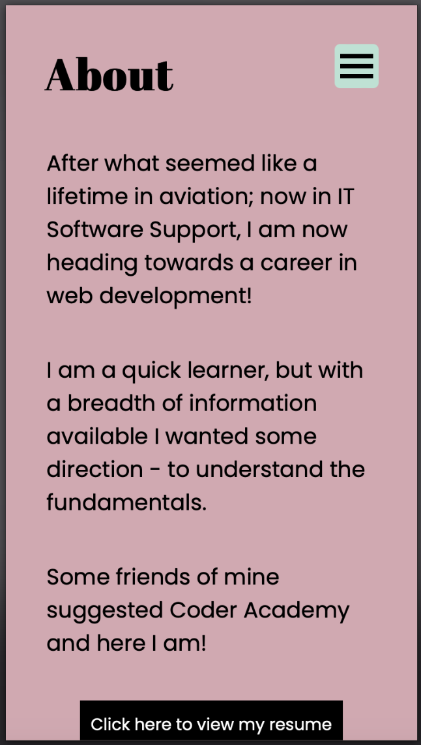
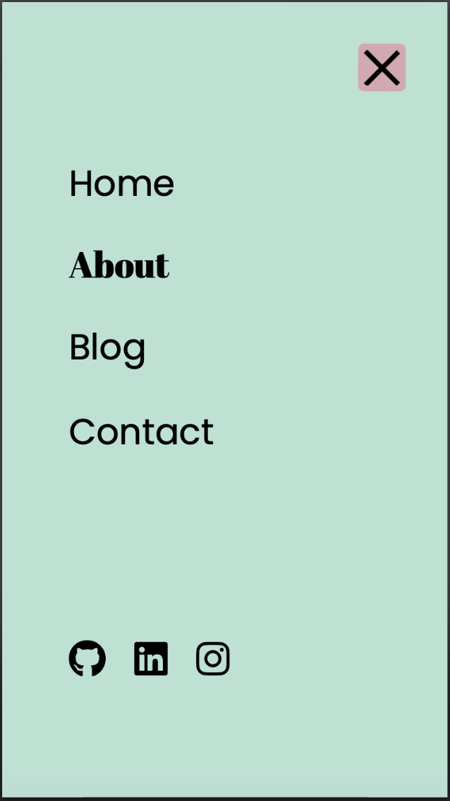
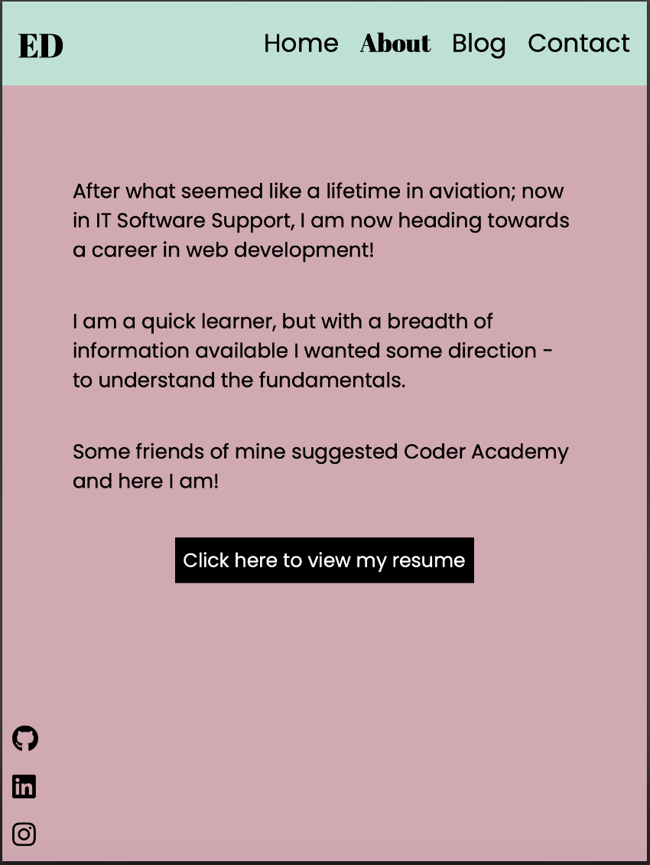
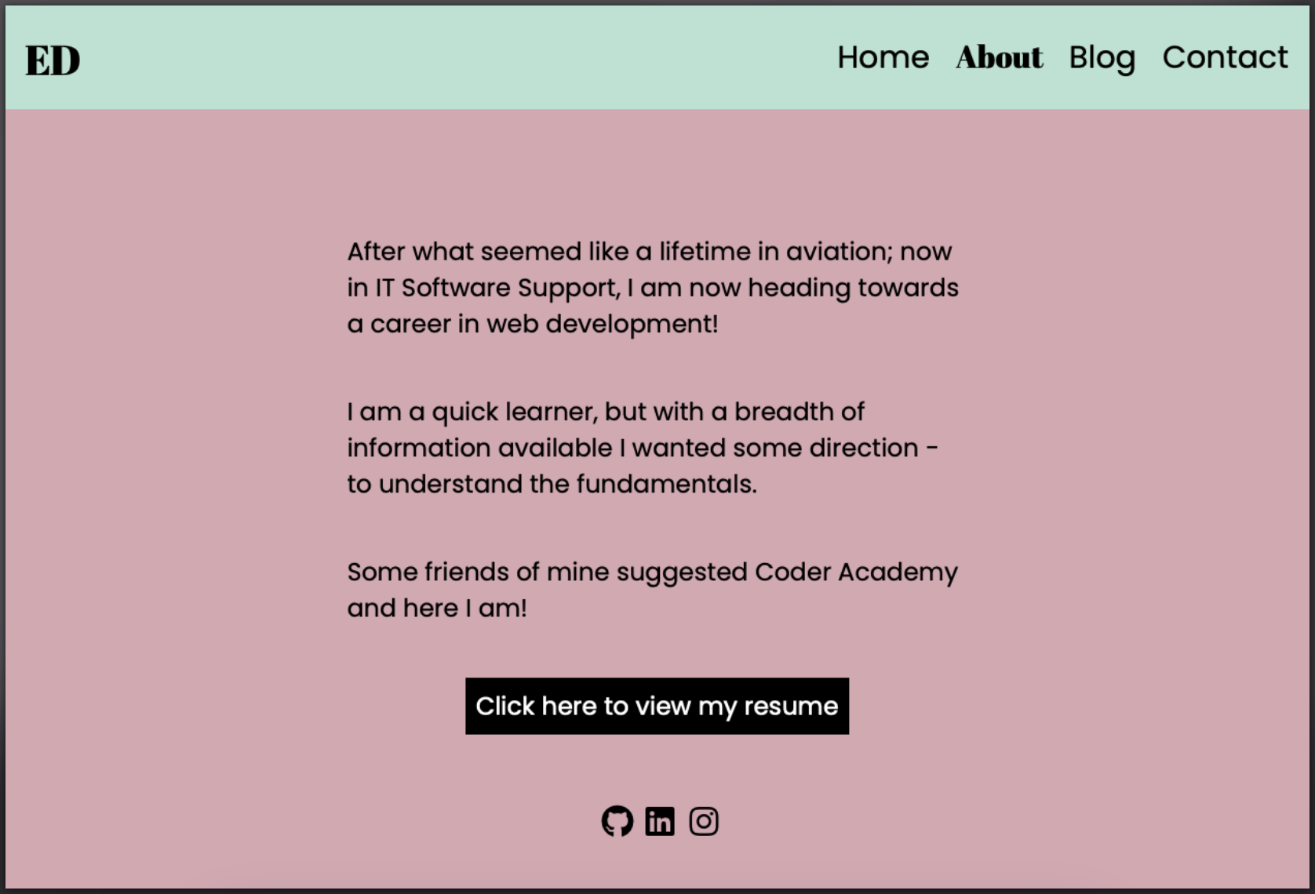
Portfolio Site – About Page
Features:
Small/Mobile View
Scaling text with easy readability.
‘About’ heading lets users know which page they are on, as well as allows users to go home.
Medium/Tablet View
Scalable elements
Social elements left hand side
Visible header
Large/Desktop View
Centred elements for wider displays

Slide 5
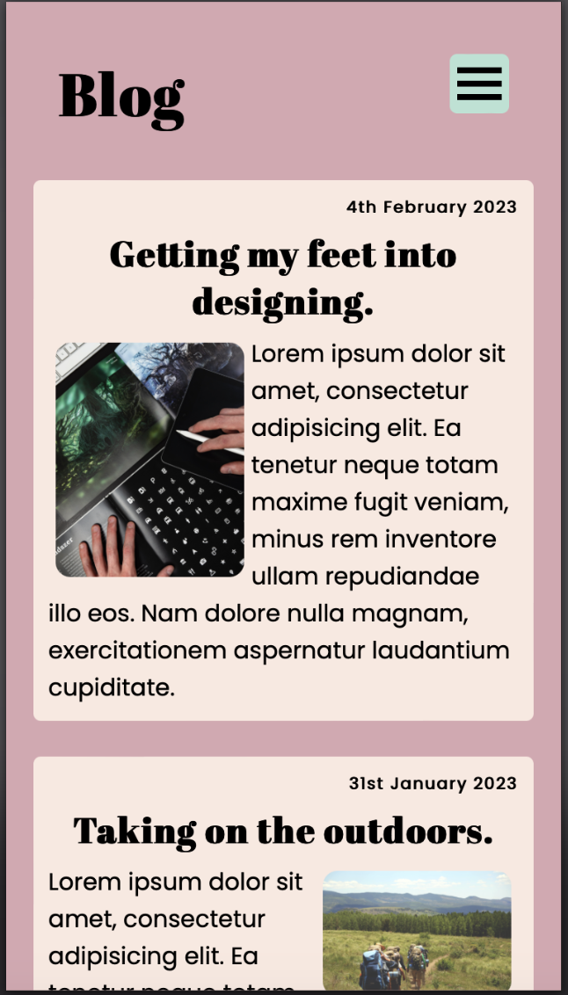
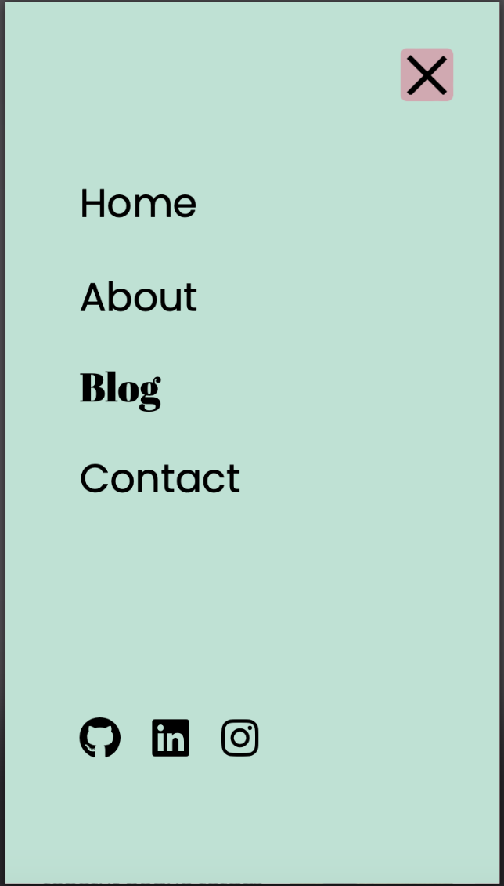
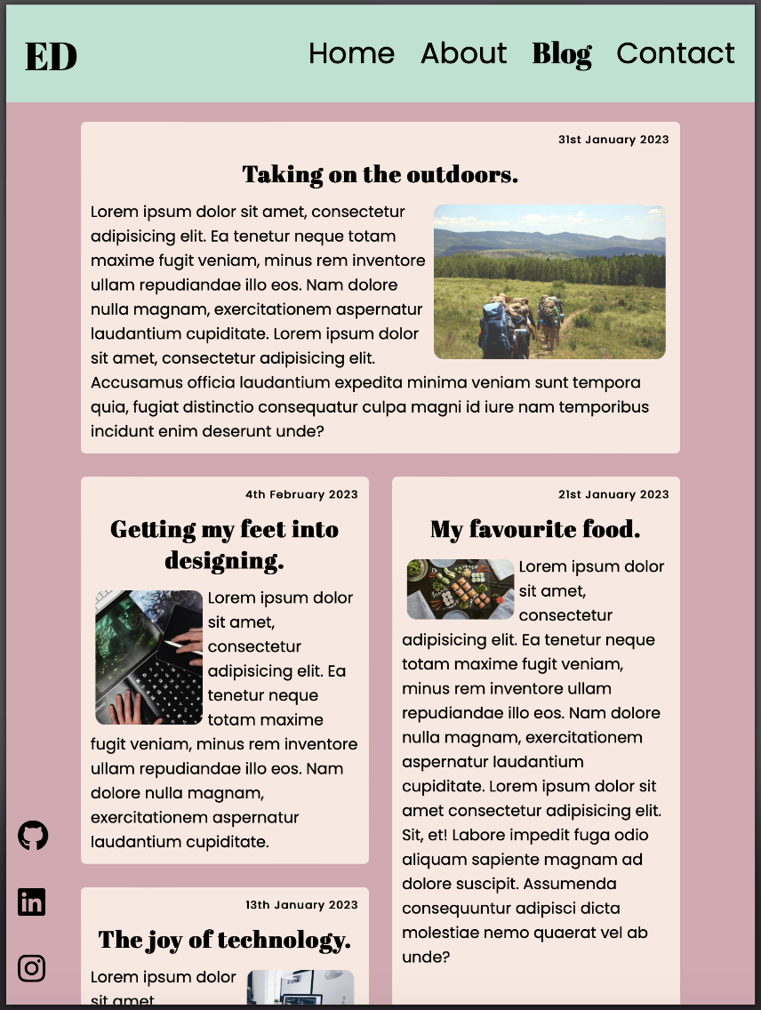
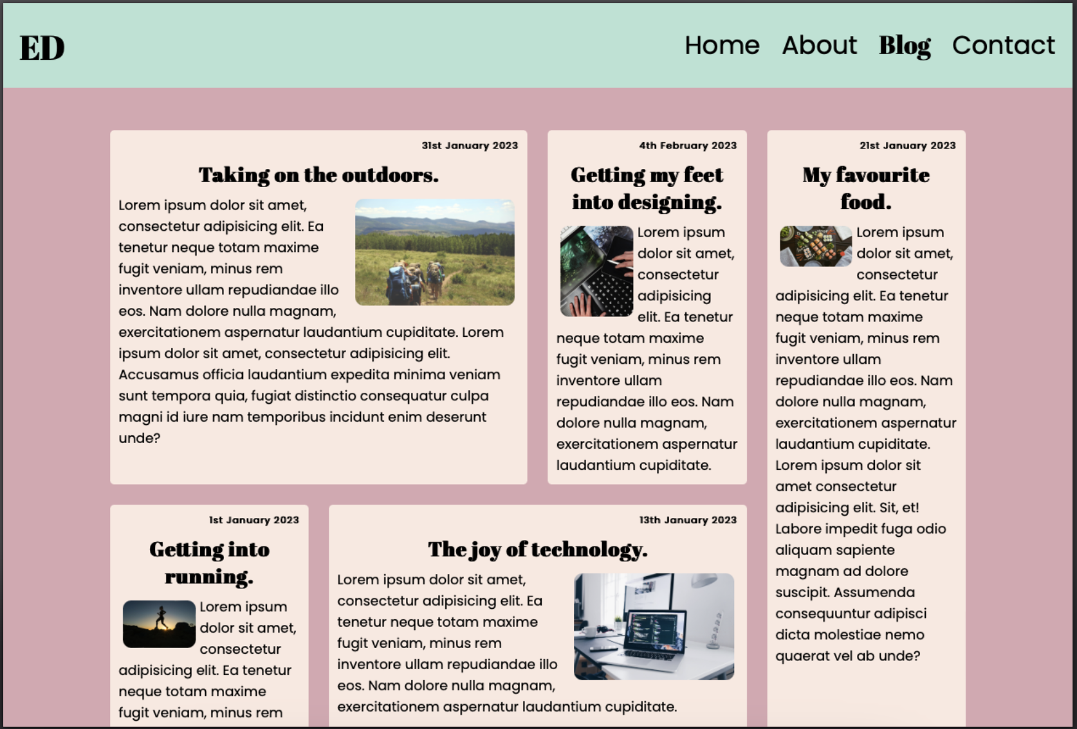
Portfolio Site – Blog Page
Features:
Small/Mobile View
Scaling text with easy readability.
‘About’ heading lets users know which page they are on, as well as allows users to go home.
Medium/Tablet View
CSS Grid changes layout
Large/Desktop View
CSS Grid conforms to larger screen sizes.

Slide 6
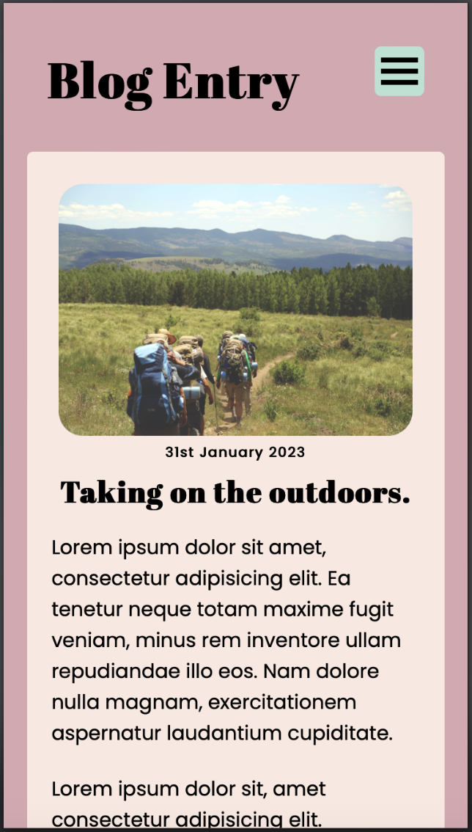
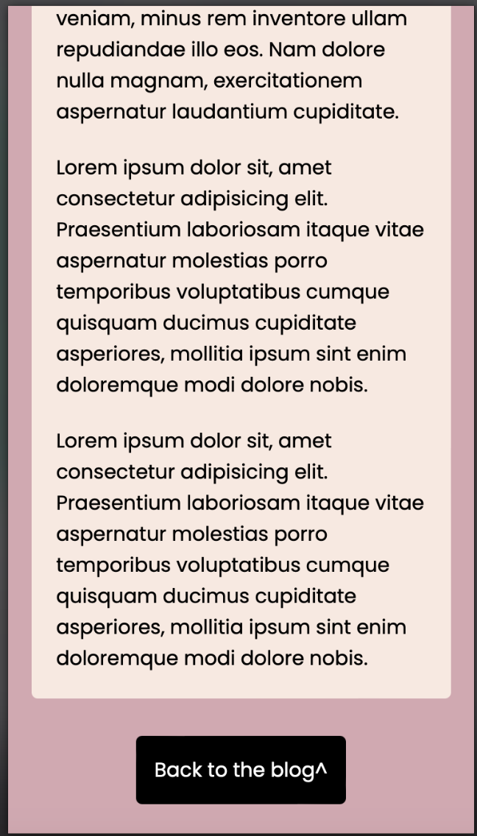
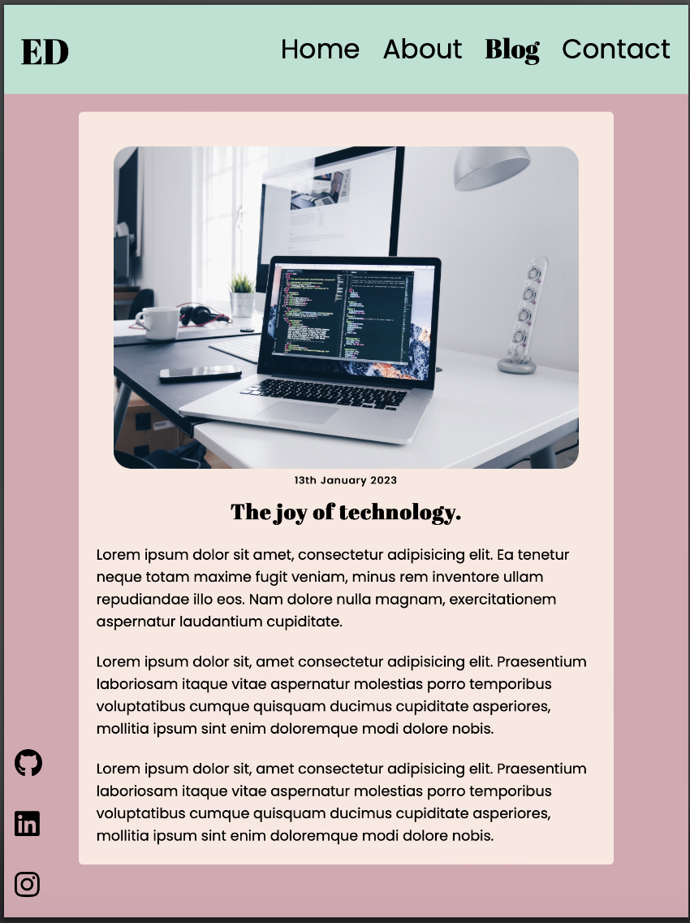
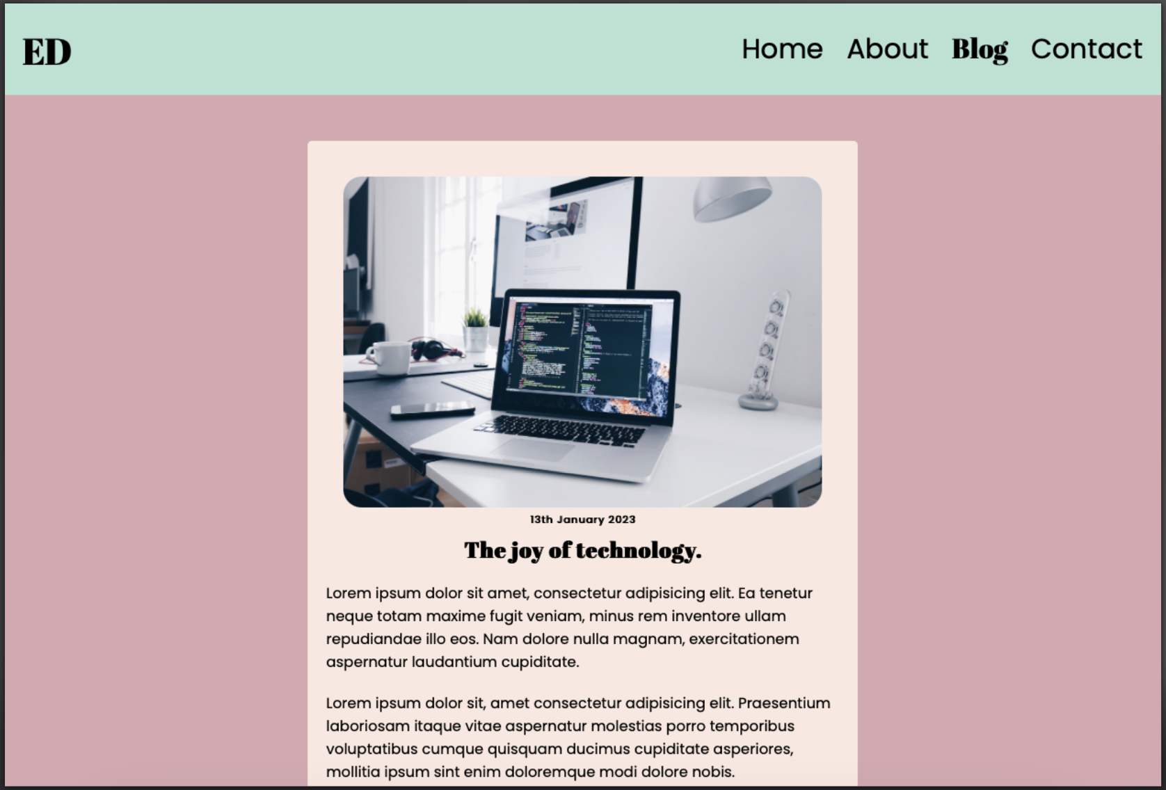
Portfolio Site – Blog Entries
Features:
Small/Mobile View
Retains the look of the grid
‘Back to the blog^’ button
Medium/Tablet View
’Paper like’ view
Large/Desktop View
Max width set for larger screens.

Slide 7
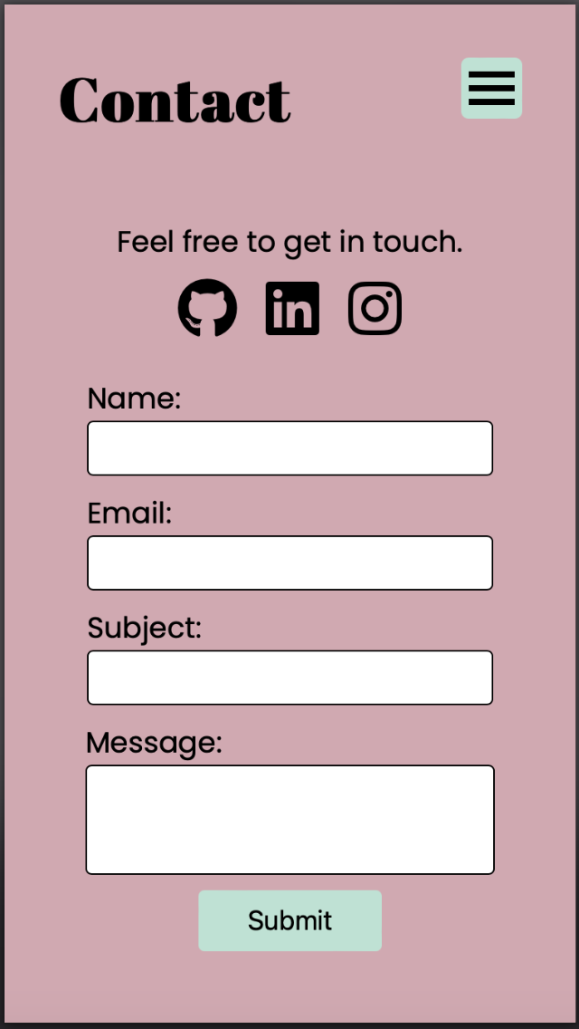
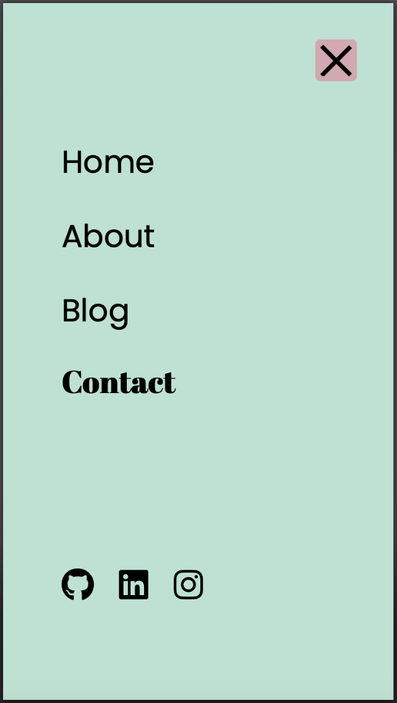
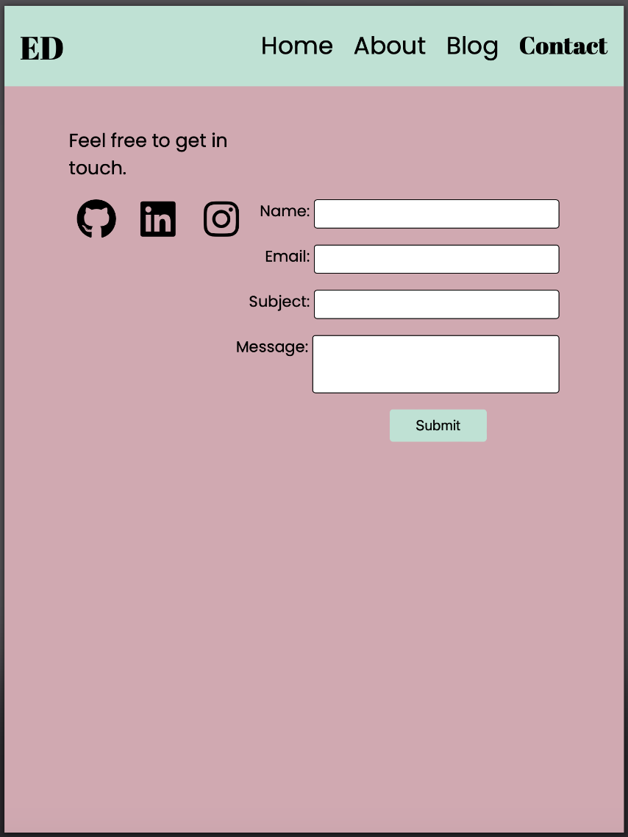
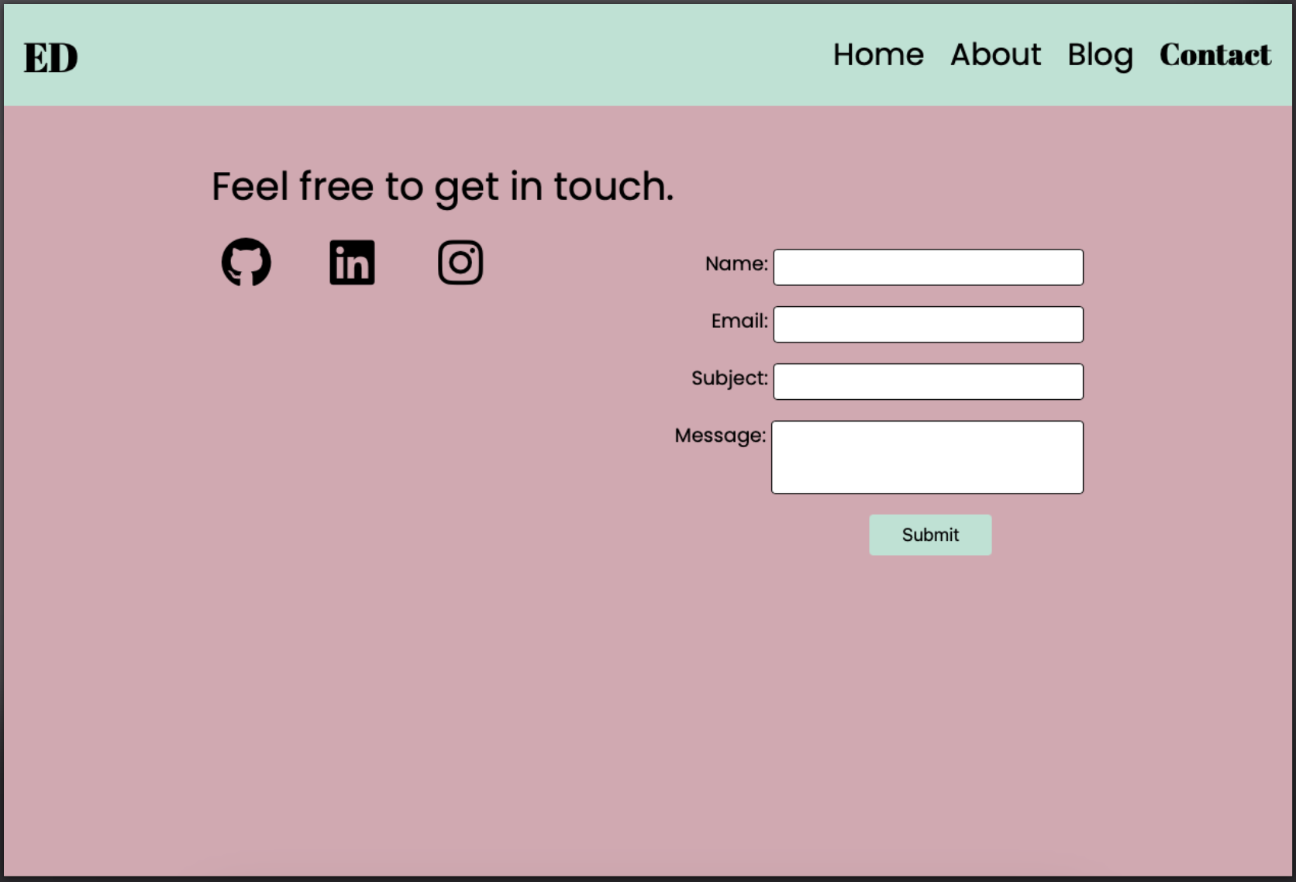
Portfolio Site – Contact Page
Features:
Small/Mobile View
Easy access icons.
Simple form
Medium/Tablet View
Simple layout, which works on a tablet.
Large/Desktop View
Scalable text

